Slide 1
LEAF DISEASE DETECTION
CAPSTONE PROJECT
Presented By:
M. Divyadharshini – Mangayarkarasi College of Engineering – B. Tech Agricultural Engineering

Slide 2
OUTLINE
Problem Statement
Proposed System/Solution
System Development Approach
Algorithm & Deployment
Result
Conclusion
Future Scope
References

Slide 3
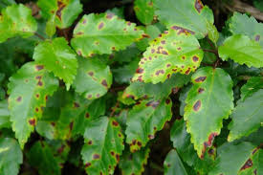
Problem Statement
The study of plant diseases is important as they cause loss to the plant as well as plant produce. The various types of losses occur in the field, in storage or any time between sowing and consumption of produce.
Without proper identification of the disease and the disease-causing agent, disease control measures can be a waste of time and money and can lead to further plant losses. Proper disease diagnosis is therefore vital. Often, plant pathologists have to rely on symptoms for the identification of a disease problem.

Slide 4
Proposed Solution – cont.
How to identify plant disease?
Early detection and classification of plant diseases is critical for increasing agricultural productivity . Plant diseases reduce crop results by having a negative impact on the crop. Plant disease identification is a major challenge in agriculture for both farmers and experts
Early plant disease detection is important in agriculture as it helps prevent crop yield loss caused by diseases caused by bacteria, viruses, and fungi. The paper discusses the use of deep learning techniques, specifically CNNs, for plant disease detection.
There are a variety of symptoms of plant disease such as spots, dead or dying tissue, fuzzy spores, bumps, bulges, and irregular coloration on the fruits. The disease triangle consists of a susceptible plant, a pathogen, and favorable environmental conditions that allow the pathogen to infect the plant.

Slide 5
PROPOSED SOLUTION
Data set creation, Train, Test, Val
CNN Design
Pre Processing
Training model
Block diagram – Workflow of image classification CNN
Classification
Pre process – Input image
Load model test

Slide 6
System Approach-CONT.
Building the proposed solution would involve a combination of data processing ,feature engineering, and machine learning. Here are the key system and library requirements:
System Requirements :
Hardware ;
- A computer with sufficient processing power, preferably with multiple cores or a GPU for faster training for machine learning models.
- Adaquate RAM to handle the size of the dataset and computational requirements.
Software ;
- An operating system compatible with the required machine learning libraries (e.g., Python, Jupyter Notebook)

Slide 7
SYSTEM APPROACH
Library Requirements :
Data processing and analysis:
- Keras – Keras is a high-level, deep learning API developed by Google for implementing neural networks. It is written in Python and is used to make the implementation of neural networks easy. It also supports multiple backend neural network computation.
- Numpy –is widely used for data manipulation, mathematical operations and array processising.
Data visualization:
- Matplotlib – It is a comprehensive library used for creating static, animated and interactive visualizations In python.

Slide 8
Algorithm & Deployment – CONT.
Problem Understanding and Data : Collection:Understand the problem domain and the types of diseases affecting leaves.Collect a diverse dataset of leaf images containing both healthy and diseased samples for training and evaluation
.Data Preprocessing : Preprocess the collected images by resizing, cropping, and normalizing them to a standard size and format. Augment the dataset if necessary by applying transformations such as rotation, flipping, or changing brightness and contrast to increase its diversity.
.Feature Extraction features:Use techniques like Gabor filters, Local Binary Patterns (LBP), color histograms, and contour analysis to capture discriminative :Extract relevant features from the preprocessed images, such as texture, color, and shape characteristics of healthy and diseased leaves

Slide 9
ALGORITHM & DEPLOYMENT – CONT.
Algorithm Development:
Choose an appropriate algorithm or model architecture for leaf disease detection
.For deep learning-based approaches
Fine-tune pre-trained CNN models using transfer learning to leverage knowledge from large-scale image datasets
Design and implement a Convolutional Neural Network (CNN) architecture suitable for the task
.For traditional machine learning approaches
Select a machine learning algorithm such as Support Vector Machines (SVM), Random Forest, or k-Nearest Neighbors (k-NN)
Train the model using handcrafted features extracted from the leaf

Slide 10
ALGORITHM & DEPLOYMENT
Model Training and Evaluation:
Split the dataset into training, validation, and test sets
.Train the algorithm/model on the training data and tune hyper parameters using the validation set
.Evaluate the trained model's performance on the test set using appropriate evaluation metrics such as accuracy, precision, recall, and F1-score

Slide 11
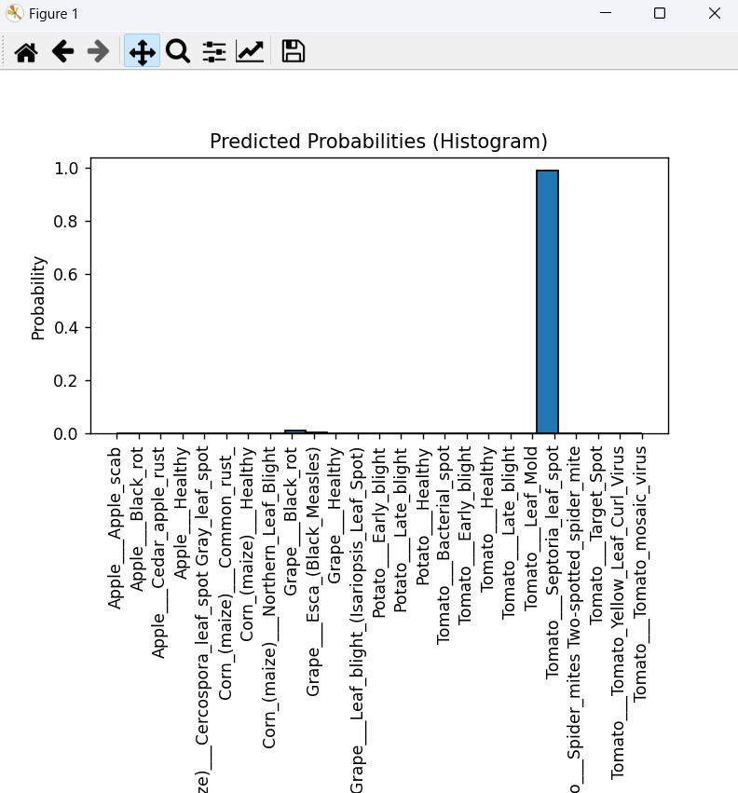
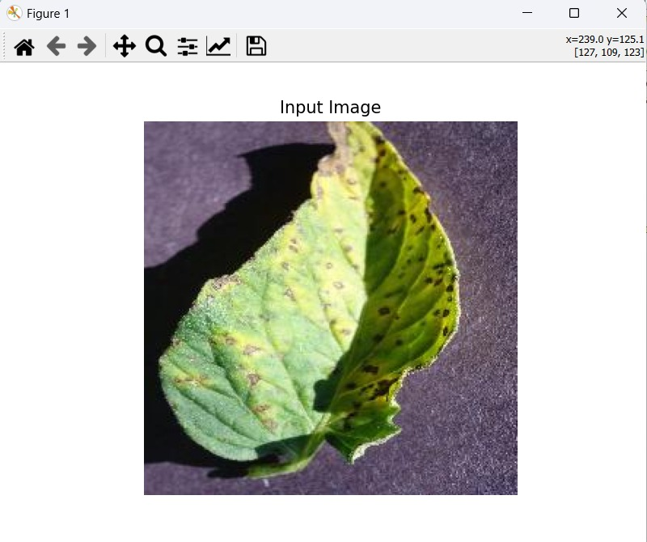
RESULT – CONT.

Slide 12
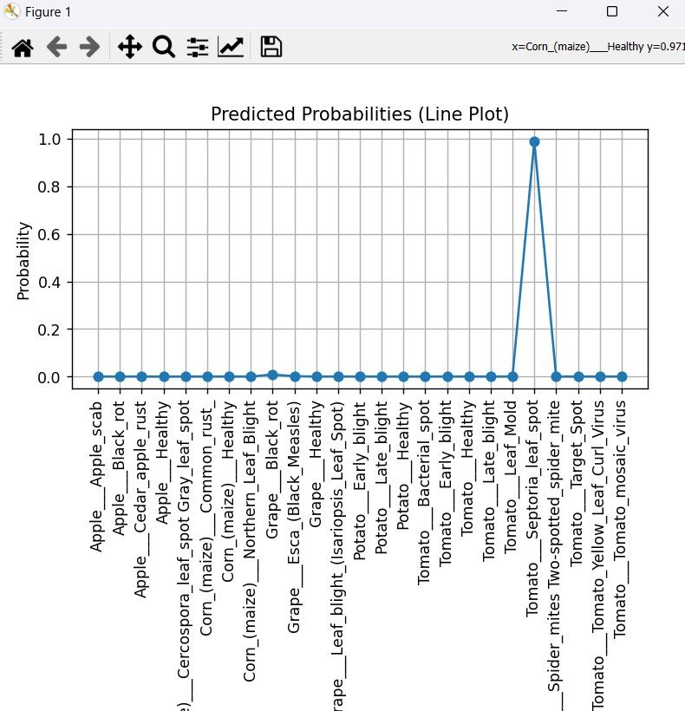
RESULT

Slide 13
Conclusion
In conclusion, a leaf disease detection project aims to develop an automated system for identifying and classifying diseases affecting plant leaves based on image analysis
Overall, a successful leaf disease detection project can help farmers and agricultural experts detect and manage plant diseases more efficiently, leading to improved crop yields and reduced economic losses. Additionally, such systems contribute to sustainable agriculture practices by enabling timely and targeted interventions to prevent the spread of diseases and minimize the use of pesticides.

Slide 14
Future scope
The future work can also be dedicated to the automatic estimation of the severity of these diseases.
The instant solutions can be made available to the farmers by designing mobile based applications.
Online solutions related to plant diseases can be provided by using web portals.

Slide 15
References
https://www.kaggle.com/
https://numpy.org/
https://journalofbigdata.springeropen.com/articles/10.1186/s40537-023-00863-9
https://matplotlib.org/

Slide 16
THANK YOU

